Slide 1

CELSIUS* and District Heating
*Combined Efficient Large Scale Integrated Urban Systems
Jonas Cognell
2014.11.20
This project has received funding from the European Union’s Seventh Framework Programme for research, technological development and demonstration under grant agreement no 314441.
Notes:
CELSIUS – a demonstration and knowledge transfer project with focus on energy efficiency through district heating and cooling

Slide 2


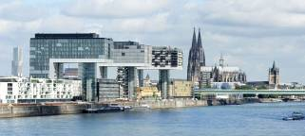


Celsius FP7 Smart Cities project
Gothenburg, London, Genoa, Cologne, Rotterdam
21 renowned partners
April 2013 – March 2017
26 MEUR; EU: 14 MEUR
12 new Demonstrators + 20 existing
7 replication cities
50 Celsius Cities

Slide 3


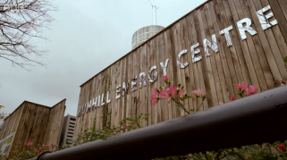

Celsius demonstrators
System integration
Sustainable production
Storage
End-user
Infrastructure

Slide 4

Support to new CELSIUS Cities
Social toolbox – acceptance and conflict resolution protocols
Technical toolbox – upscaling technologies and concepts
Road map –
building blocks transforming a city into a CELSIUS city
Celsius toolbox – collate input; find synergies to support new Celsius cities
Demonstrators – show possibilities and replicability of demonstrators
Celsius Cities

Slide 5


Gothenburg New Demonstrators
  District heating to STENA ferry
  District heating to white goods
  Short-term storage

Slide 6
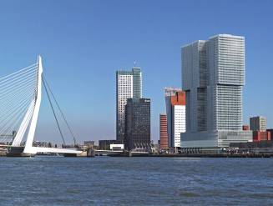
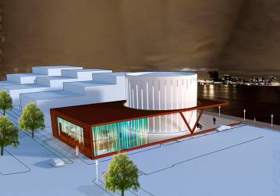
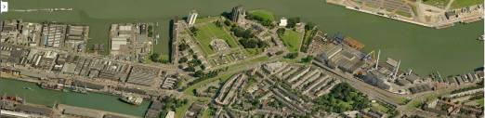
Rotterdam New Demonstrators
  Vertical City (saving 80 % cooling)
  300 MW HeatHub /Buffer Tank
  Industrial Ecology
Notes:
Vertical City (160 000m2 /apartment/offices/hotels, saving approx 80 % cooling)

Slide 7
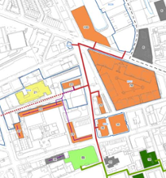

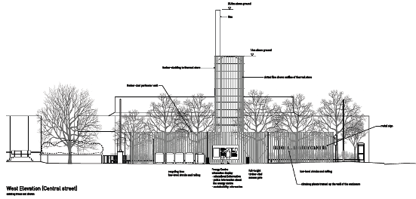
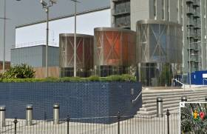
London New Demonstrators
  Active Network Management and Demand Response
  Capture of Identified Sources of Waste Heat
  Integration of Thermal Store
  Extension of the Bunhill ‘Seed’ Heating System

Slide 8
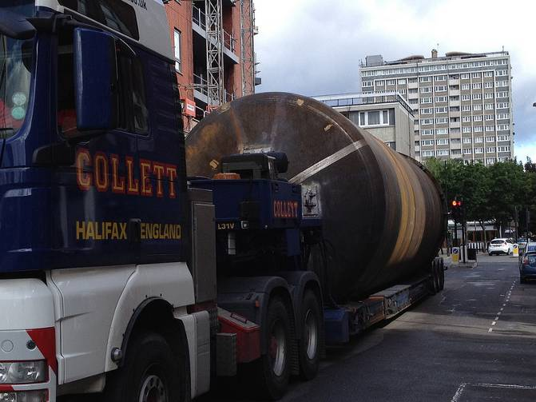
How to build District Heating in London ?
Notes:
London Borough of Islington Council recently completed the first phase of Bunhill Heat and Power, a 1km heat network served by a 2MWe gas CHP engine. The second phase (LO2 & 3) intends to recover waste heat from a large electricity substation and a London Underground mid-tunnel ventilation shaft using heat pump technology. It also aims to provide heating to an additional 620 council owned homes and around 1,000 new build homes, 5,000m² commercial space, student and hotel accommodation. The plans include a hydraulic connection to the first phase’s heat network, which currently serves 880 residential council homes and two leisure centre
Heat is generated from electrical transformers during their normal activity as a result of losses incurred during voltage conversion. At UK Power Network Ltd.’s (UKPN) City Road substation the transformers are cooled using an oil system and the heat is currently lost to the environment. Separate from the sub station, a nearby London Underground mid-tunnel ventilation shaft ventilates the tube through the use of mechanical ventilation exhausting warm air into the environment. Islington Council aim to capture this waste heat and use it to heat 620 council owned homes and potentially up to 1,000 new build homes, commercial space, student and hotel accommodation. The heat will be captured using heat exchangers and heat pump systems. The heat pump COP’s achievable are estimated to be approximately 3 for the ventilation shaft to approximately 5.5 for the electrical transformer at peak operating temperature. The peak thermal output available (approximately 1.16 MW) is expected to meet the base load for the connected properties, allowing the waste heat to be utilised all year.
Islington Council plan to incorporate a thermal store near to the electrical substation heat pump to even out demand if necessary. The initial feasibility study suggested a 130 m³ store should meet this requirement. CHP generation is also being considered to drive the heat pump.
Phase 1 and Phase 2 of the district heating network are planned to be hydraulically connected. This will result in a challenging operation and controls design and may result in differing supply temperatures on the network, or variable seasonal operating temperatures.
2 MWe reciprocating gas CHP engine
Heat meters
115m³ Accumulator/thermal store

Slide 9
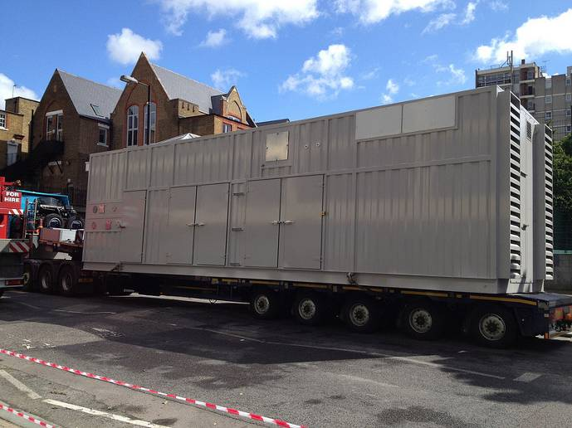
How to build District Heating in London ?

Slide 10
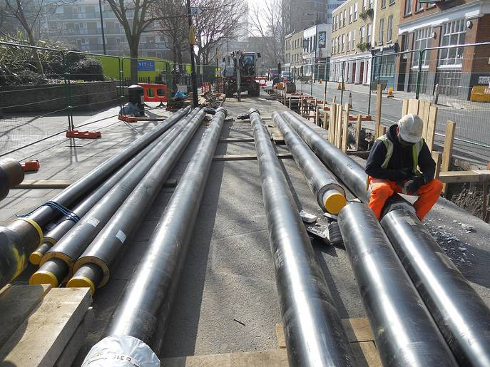
How to build District Heating in London ?

Slide 11
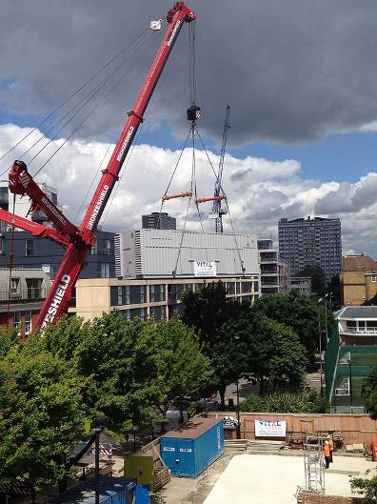
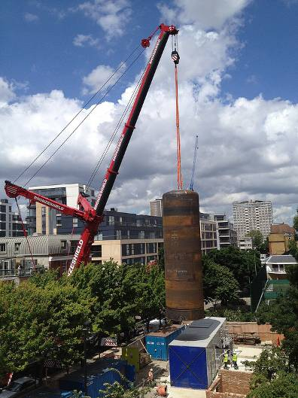
How to build District Heating in London ?

Slide 12
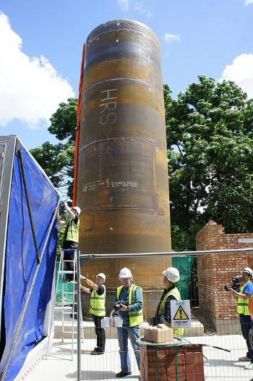
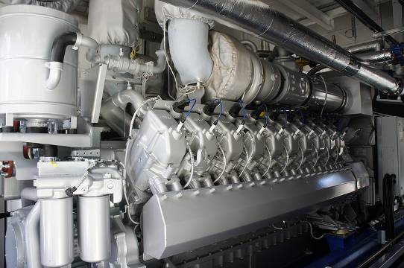
How to build District Heating in London ?

Slide 13
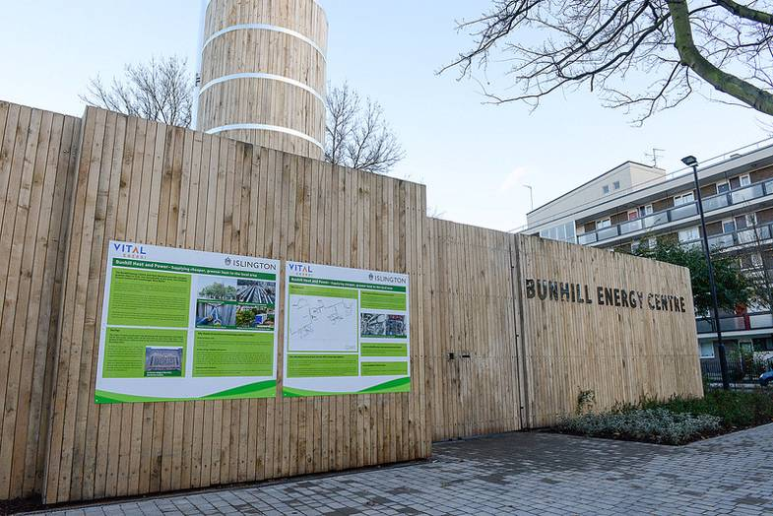
How to build District Heating in London ?

Slide 14
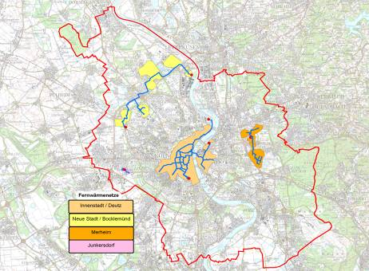

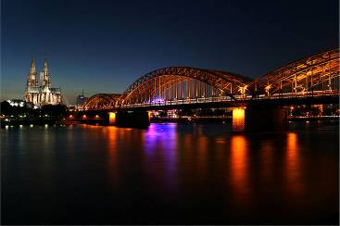
Cologne New Demonstrators
  Waste heat recovery from sewage water- focus supply side
  Waste heat recovery from sewage water – focus demand side
Local Heating Network

Slide 15


Genua New Demonstrators
  Energy recovery from the natural gas distribution network (GEN1)
  Rationalization of consumption patterns through system integration and control (GEN2)

Slide 16
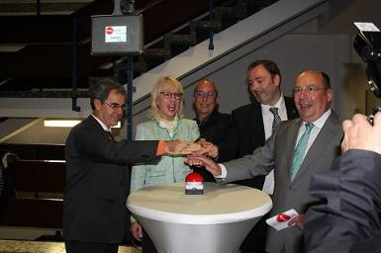
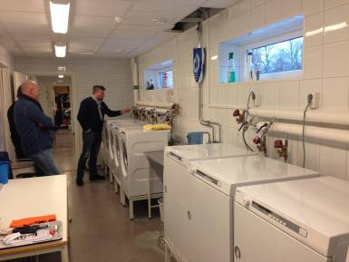
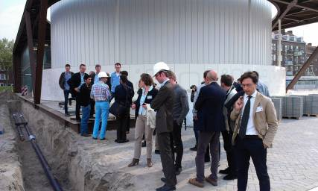
Demonstrator Inaugurations
Köln – Oktober 2013
DH from sewage to schools
Göteborg – March 2014
DH to White goods
Rotterdam – April 2014
Heat storage, 300 MWh/50 MW

Slide 17

Upcoming Inauguration
Gothenburg: DH to ship in harbour

Slide 18






Last Event
Conference on the Security of Energy Supply and District Heating
Date: Thursday 16th of October
Place: European Parliament
Hosted by the City of Gothenburg together with the other partner cities – London, Cologne, Rotterdam and Genoa.

Slide 19
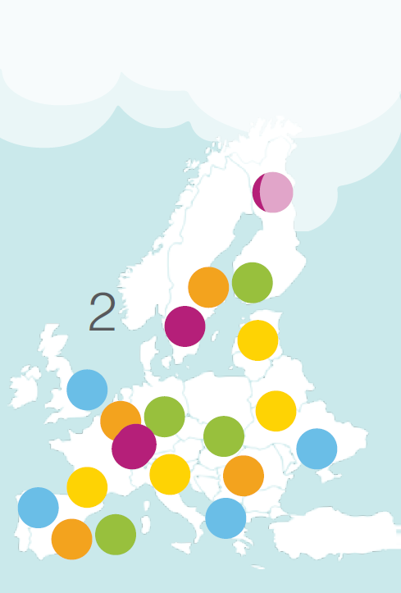
CELSIUS Outcome
Recruit 50 new CELSIUS Cities
Impact on
  Energy efficiency
  Decrease in use of primary energy sources
  Decrease in greenhouse gas emissions
  Air quality
  Security of Supply
  Fuel poverty

Slide 20

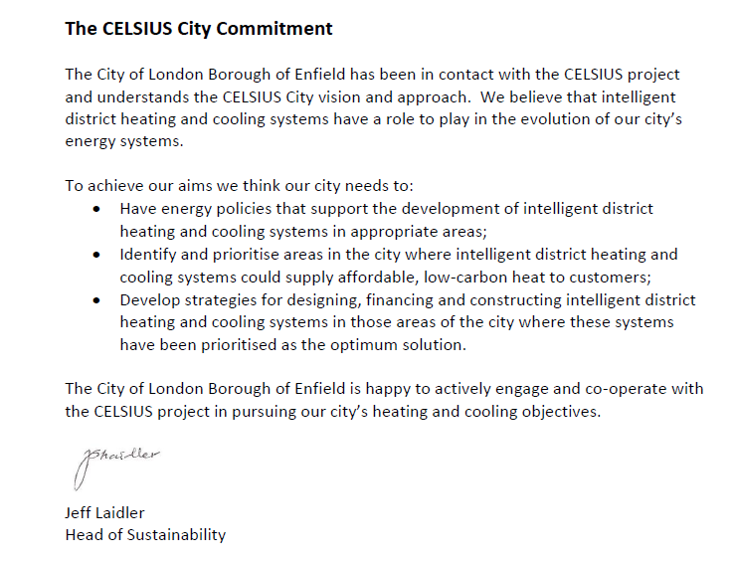
CELSIUS Outcome

Slide 21

Thank you!
www.celsiuscity.eu

